Slide 1


Chapter 5
Installing Windows on a Virtual Machine
Virtualization Essentials

Slide 2
Chapter 5 Objectives
Understand the steps to load Microsoft Windows into a virtual machine
Understand the step needed to install the VMware Tools into a Windows virtual machine
Examine some virtual machine configuration options
Examine some optimizations for a Windows virtual machine
2

Slide 3
Installing Windows into a VM
Same process as installing Windows onto a physical server
Choose boot device at power-on
DVD or ISO image file
Illustrated walk-through is just one installation path, not the definitive one
3

Slide 4
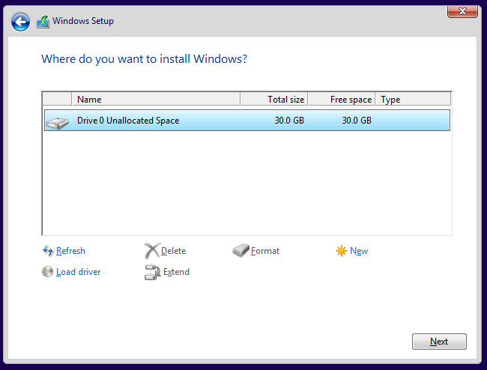
Virtual Hardware
The Windows installer can only see what has been allocated to the virtual machine
30 GB disk
2 GB memory
4

Slide 5
Examine the Virtual Machine
There are virtual machine–specific drivers
These are used to communicate with the hypervisor but are legitimate to Windows
5

Slide 6
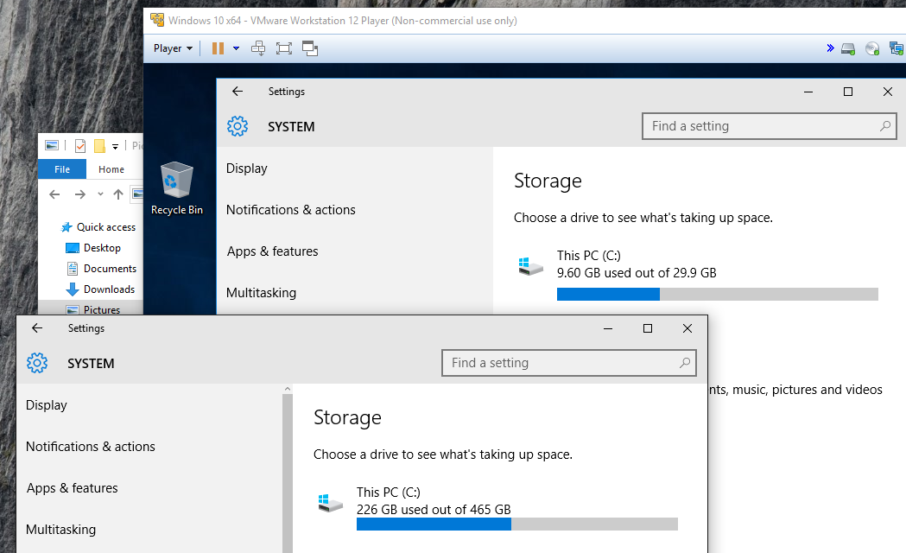
Examine the Virtual Machine (II)
Compare the allocated resource values in the virtual machine against the host values
6

Slide 7
VMware Tools
VMware Tools are installed to enhance the user experience, improve performance, and help manage the VM
Other vendor hypervisor solutions have similar enhancement packages
Recommended for all virtual machines
Additional information in Chapter 12
7

Slide 8
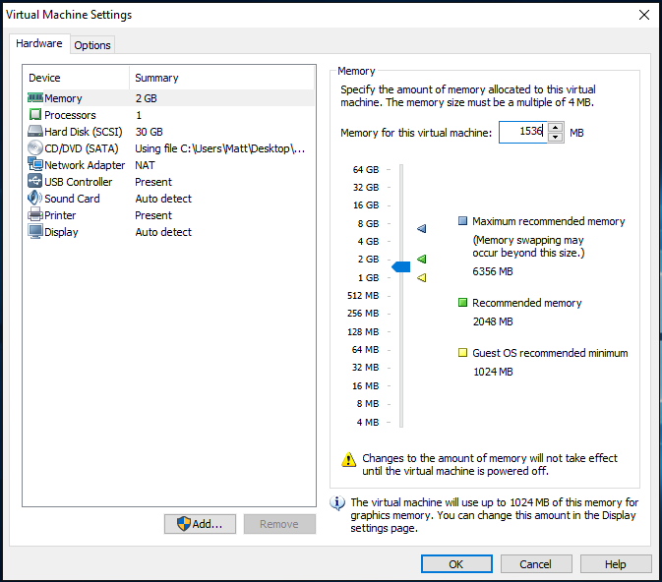
Reconfiguring Memory
Virtual machines allow rapid reconfiguration
Adding resources takes minutes instead of days or longer
8

Slide 9
Virtual Machine Optimizations
Some processes that run on Windows are not necessary in a virtual environment
By removing them you can save processing and memory resource
A necessary procedure because wastage and savings multiply because of consolidation
The removal of other extraneous components like wallpaper and screen savers also contribute to efficiency
The Windows installation should be as lean as possible; there are documents available that provide optimization specifics
9

Slide 10
Chapter 5 Summary
Installing Windows into a virtual machine is identical to the physical server installation process
VMware Tools are installed to enhance the user experience, improve performance, and help manage the VM
Inspection of the system configuration can determine whether it is a physical or virtual server
Certain Windows processes and components can and should be eliminated from a virtual machine deployment as they waste resources or are not applicable to a virtual deployment
10

